Slide 1


COMMISSIONER CABINET
Monthly Training

Slide 2
William Koller
Seneca District Commissioner
Effective Relations with the District Committee
April 15, 2014

Slide 3
Effective Relations
It takes an entire District to Support a Unit

Slide 4
Effective Relations
Why:
Unit Commissioners focus on four primary areas:
>Supporting unit growth in the JTE criteria
  >Linking district committee resources to units
  >Visiting units and logging the visits into UVTS
  >Supporting on-time charter renewal
Notes:
We should support the district committee's delivery of a "catalog of services" to support the specific JTE elements needed for a particular unit's health and success.

Slide 5
Tonight’s Discussion
Relationship Model, District Committee Functions and Organization
Opportunities to Build Relationships
Personal Relationship Basics

Slide 6
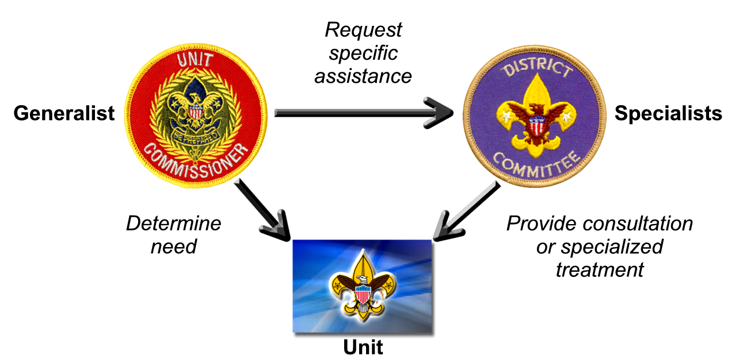
Relationship Model
“Seek first to understand, then to be understood.”
Stephen R. Covey

Slide 7
District Committee Functions
Membership
Finance (Fund Development)
Program
Unit Service

Slide 8
Seneca District Organization
District Chairman
Roger Dickhans
District Vice-Chair
Ron Garmey
Nominating
Special Awards
Vice Chm. Program
Anthony Waters
Training
Activities
Camp Promotions
Advancement
OA Advisor
Vice Chm. Membership
Reed Waters
Recruiting
Round-Ups
Relationships
Marketing / Publicity
District Commissioner
Bill Koller
Unit Visits
Roundtable
JTE
Popcorn
Family FOS
“Know your resources.”

Slide 9
Seneca District Committee
38 “Named” Committee Positions
1 Chairman
3 Vice-Chairs
11 Sub-Committee Chairs
23 Activity Directors
Roughly 2/3 positions presently Filled
13 Commissioners Serving 45 Units
Know the people and what they do.
Recruit and develop people as a team.

Slide 10
Consider Changing Roles
Separate “Development” Vice-Chm?
Commissioner focus on Unit Service
Divide “Program” in Two?
Advancement and Training
Activities / Camp Promotion

Slide 11
Meetings and Interactions
Key 3 Meetings
District Committee Meetings
Commissioner Staff Meetings
Roundtables

Slide 12
Key 3 Meetings (2x Month)
Who:
District Chairman
Service Executive (Field Director)
District Commissioner
Relationship Building:
District JTE
Fundraising
Strategic Vision; 90-Day Planning
Organization and Leadership Assessment

Slide 13
District Committee (Monthly)
Who
District Chair / Vice Chairs / Sub-Committee Chairs
Service & Program Executive (Field Director)
DC / ADCs / Roundtable Staff
Relationship Building:
Committee Reports – Advancement / Membership / Training / Program
Unit Service / Roundtable Priorities

Slide 14
Commissioner Staff Meeting
Who
All Commissioners (DC, ADC, UC, Roundtable)
Service Executive
District Chairman
Relationship Building:
Set Unit Service priorities based on District Committee reports / feedback
Factor Committee feedback into Unit Health Assessments

Slide 15
Roundtable (Monthly)
Who
All District Committee
Service & Program Executive (Field Director)
Commissioner Staff
Unit Leaders / Committee Chm / Others
Relationship Building:
Keep Informed
Connect Unit Leaders w/ District Committee
Shared Roundtable Discussions

Slide 16
Relationship Basics
Shared objective –
Helping units provide quality programs to youth
Interdependence
Mutual respect and confidence
Avoid “turf wars” –and- “overzealous delegation”
“Neither partner has a monopoly on wisdom, judgment, or experience.”
Administration of Commissioner Service

Slide 17
Closing Thought -
On Responsibility
“Responsibility is a unique concept. It can only reside in a single individual.
You may share it with others, but your portion is not diminished. You may delegate it, but it is still with you …
If responsibility is rightfully yours, no evasion, ignorance, or passing the blame to others can shift the burden to someone else …”
Adm. Hyman G. Rickover

Slide 18

Notes:
Thank You

